Slide 1

Project Title:
RESTAURANT MANAGEMENT SYSTEM USING C++
Project Review 1&2
Department of
Artificial Intelligence and Machine Learning
Team Members : Registration Number: Branch:
K . Jaswanthi 25B11AI619 AIML
T. Sanjana 25B11AIB85 AIML
R.P. Chandrasekhar 25B11AIA43 AIML
P. Haribabu 25B11AI935 AIML
Guide:- Vijaya Lakshmi
Co-Guide:- Sudheer
Assistant Professor
Department Of AIML

Slide 2
Outline:
Project Title & Team Members
Project Objective
Project Progress – Review 1 to Review 2
System Modules
Order Structure & STL Vector
Core Function – calculateTotals()
File Handling – CSV Storage
Input Validation

Slide 3
GUI & Event-Driven Programming
C++ Concepts & STL Used
Testing & Validation
Application Output
Team Member Contributions
Future Enhancements
Conclusion

Slide 4
ABSTRACT:
The Restaurant Management System using C++ is a simple application that helps manage common restaurant activities. It allows staff to view menu items, take customer orders, calculate bills, update orders, and maintain order records. The project is developed using C++ programming concepts such as functions, conditional statements, loops, classes, structures, and file handling.

Slide 5
INTRODUCTION:
A Restaurant Management System using C++ is a simple software application that helps manage restaurant activities. It allows staff to view menu items, take orders, calculate bills, update orders, and store order details. This project helps us understand how C++ programming concepts can be used to develop a real-world restaurant application.

Slide 6
PROBLEM STATEMENT:
The main problem addressed by this project is to create a simple and efficient system for managing restaurant orders without relying on manual records. The system should allow staff to view menu items, take customer orders, calculate bills, and manage order details. The project aims to provide an easy-to-use restaurant management system while applying basic C++ programming concepts.

Slide 7
Objectives:
To create a simple ATM system using C++.
To allow users to check their order total.
To provide options for cash remove item and add item.
To allow users to change their Order ID securely.
To perform ATM orders quickly and accurately.
To use C++ concepts like classes, objects, functions, and loops.
To provide a simple and user-friendly ATM interface.

Slide 8
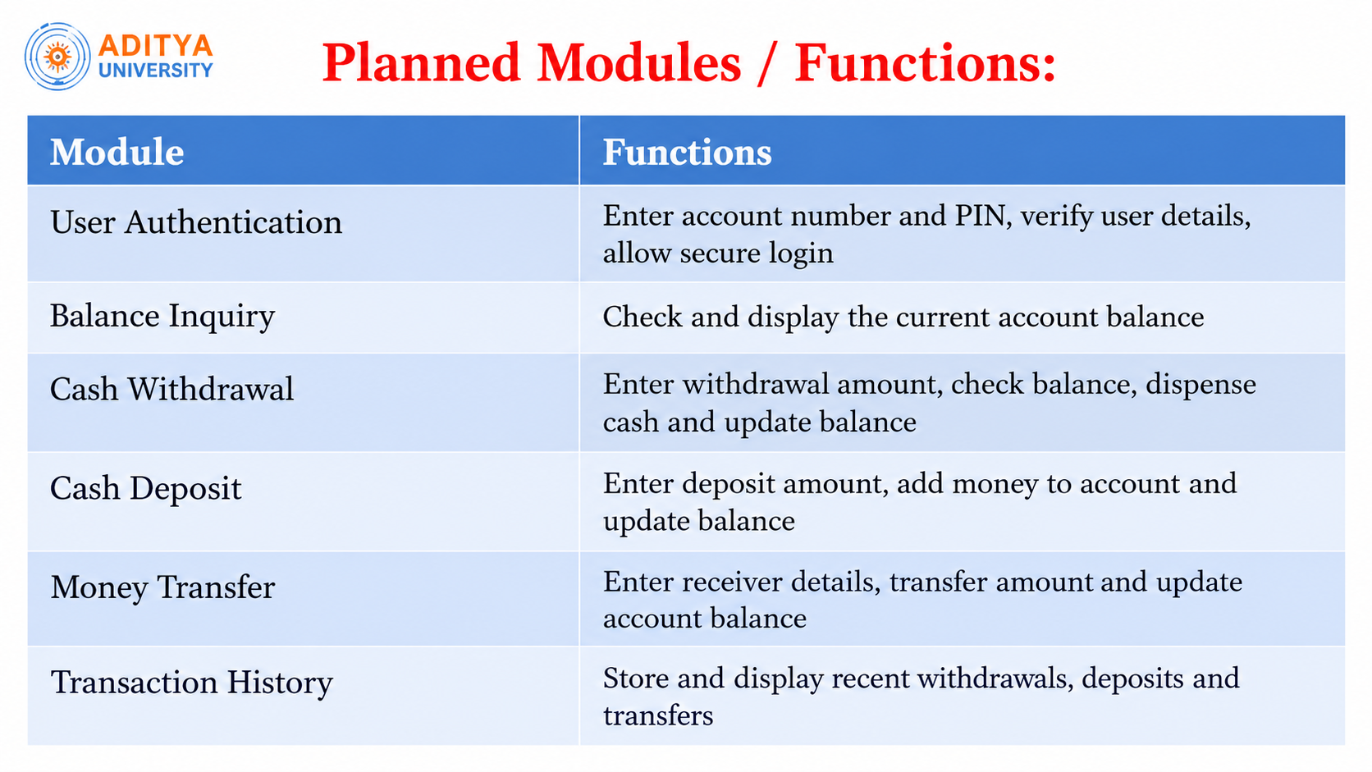

Slide 9
Inputs:
Operation | Input
Account Number | 1001
PIN | 1234
Select Option | 1. Balance Check
Withdrawal Amount | 2000
Deposit Amount | 5000
Transfer Account Number | 1002
Transfer Amount | 1000
Logout | Loggedout

Slide 10
Expected Outputs:
1. Order Entry
The staff enters the customer and table details and selects menu items.
2. Main Dashboard
The dashboard shows options such as View Menu, Add Item, Remove Item, View Order, Calculate Bill, and Exit.
3. Feature Operations
View Menu: Displays available food items and prices.
Add Item: Adds a selected food item to the order.
Remove Item: Removes an item from the order.
Calculate Bill: Calculates the final order amount.
Exit: Closes the restaurant screen.
4. Order Summary
The selected items, quantities, and final bill are displayed.
5. Completion
The order is saved and the system exits safely.

Slide 11
Algorithm:
Start
Enter the Order ID.
Check whether the Order ID is correct.
If the Order ID is correct, display the restaurant menu.
Select an option:
Check Balance
Add Item Money
Remove Item Money
Exit
Perform the selected operation.
Display the updated order total if required.
Repeat the menu until the user selects Exit.
Display Thank You.
Stop.

Slide 12
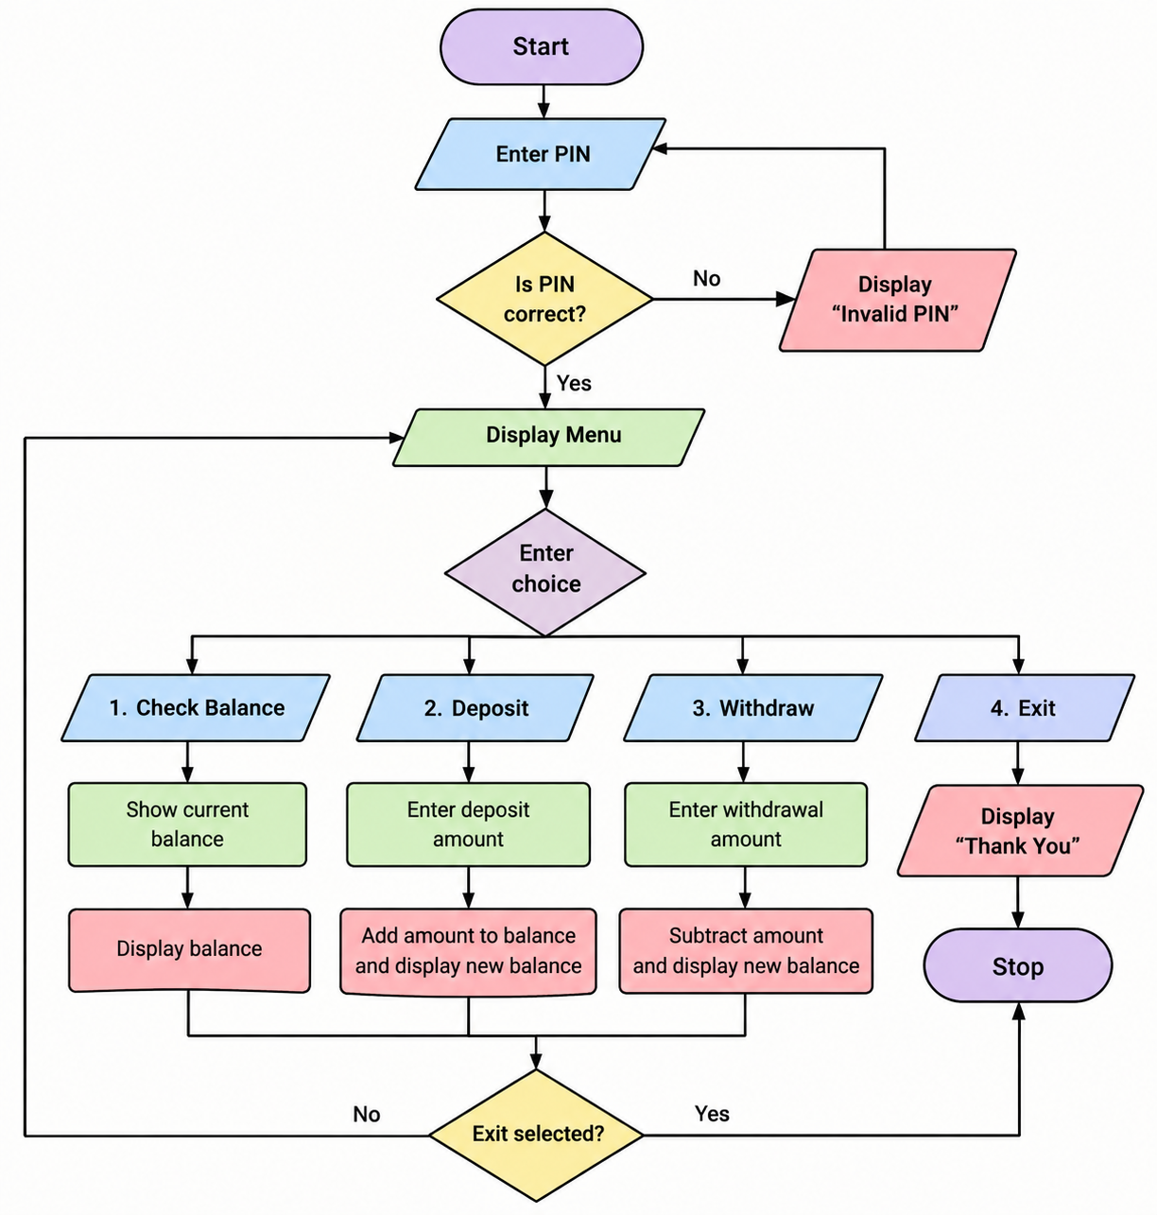
FLOWCHART:

Slide 13
C++ Concepts and STL Used
Category | Concept / STL | Use in Project
C++ Concept | Classes & Objects | Store ATM and account details
C++ Concept | Encapsulation | Keep data and functions together
C++ Concept | Functions | Perform deposit, withdrawal, balance check
C++ Concept | Conditional Statements | Check PIN and transaction conditions
C++ Concept | Loops | Display the ATM menu repeatedly
C++ Concept | Constructors | Initialize account details
C++ Concept | File Handling | Store and retrieve transaction details
STL | string | Store names and text
STL | vector | Store transaction records
STL | map | Store account details
STL | iostream | Input and output
STL | iomanip | Format output and balance

Slide 14
Order Structure and STL Vector
struct Order {
string type;
double amount;
string date;
};
vector<Order> history;
Order stores the details of one ATM order.
vector<Order> stores many orders.
Push _ back() adds a new order.
Loop through the vector to show the order summary.
clear() removes all orders.

Slide 15
Core Function: Calculate Totals()
void calculateTotals() {
double add items = 0, remove items = 0;
for (int i = 0; i < history.size(); i++) {
if (history[i].type == "Add Item")
add items += history[i].amount;
else
remove items += history[i].amount;
}
cout << "Total Add Items : " << add items << endl;
cout << "Total Remove Items : " << remove items << endl;
cout << "Balance : " << add items - remove items << endl;
}
  .If the type is Add Item, the amount is added to total add items.
If the type is Remove Item, the amount is added to total remove items.
Balance = Total Add Items − Total Remove Items.
The results are displayed on the screen.

Slide 16
File Handling : CSV Storage
#include <fstr
#include<fstream>
// Save one order to the file
void saveOrder(Order t) {
ofstream file("orders.csv", ios::app);
file << t.type << "," << t.amount << "," << t.date << endl;
}
// Load all orders from the file
void loadOrders() {
ifstream file("orders.csv");
Order t;
string amount;
while (getline(file, t.type, ',')) {
getline(file, amount, ',');
getline(file, t.date);
t.amount = stod(amount);
history.push_back(t);
}
}
f stream writes a order to the file.
If stream reads the orders back into the vector.
Each line is one order, separated by commas.

Slide 17
Input Validation
double getAmount() {
double amount;
cout << "Enter amount: ";
cin >> amount;
while (cin.fail() || amount <= 0) {
cin.clear();
cin.ignore(1000, '\n');
cout << "Invalid amount. Enter again: ";
cin >> amount;
}
return amount;
}

Slide 18
GUI and Event-Driven Programming
#include <QApplication>
#include <QPushButton>
int main(int argc, char *argv[]) {
QApplication app(argc, argv);
QPushButton button("Remove Item");
// Event: when the button is clicked
QObject::connect(&button, &QPushButton::clicked, []() {
qDebug("Remove Item button clicked");
});
button.show();
return app.exec();
}
GUI means windows, buttons, and text boxes instead of a text menu.
Event-driven programming means the program waits for the user to do something.
A button click is an event.
Each event runs its own function.
connect() links the event to its function.
app.exec() keeps waiting for event

Slide 19
Testing and Validation
Test No. | Feature | Input | Expected Output | Result
1 | Deposit | 2000 | Balance increases by 2000 | Pass
2 | Withdraw | 1000 | Balance decreases by 1000 | Pass
3 | Withdraw more than balance | 9000 | "Insufficient balance" | Pass
4 | Negative amount | -500 | "Invalid amount" | Pass
5 | Letters as amount | abc | Asks for input again | Pass
6 | Wrong PIN | 1111 | "Incorrect PIN" | Pass
7 | Correct PIN | Valid PIN | Login successful | Pass
8 | File handling | Restart program | Old transactions are loaded | Pass
9 | Calculate totals | Deposit 5000, Withdraw 2000 | Balance = 3000 | Pass

Slide 20
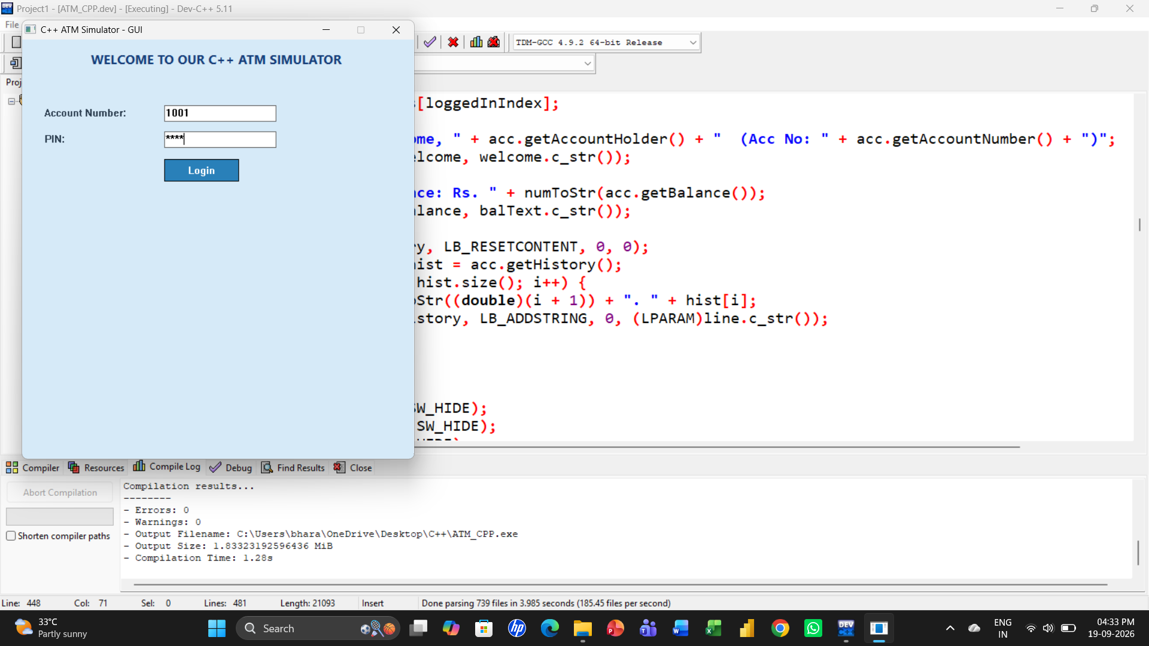
Application Output

Slide 21
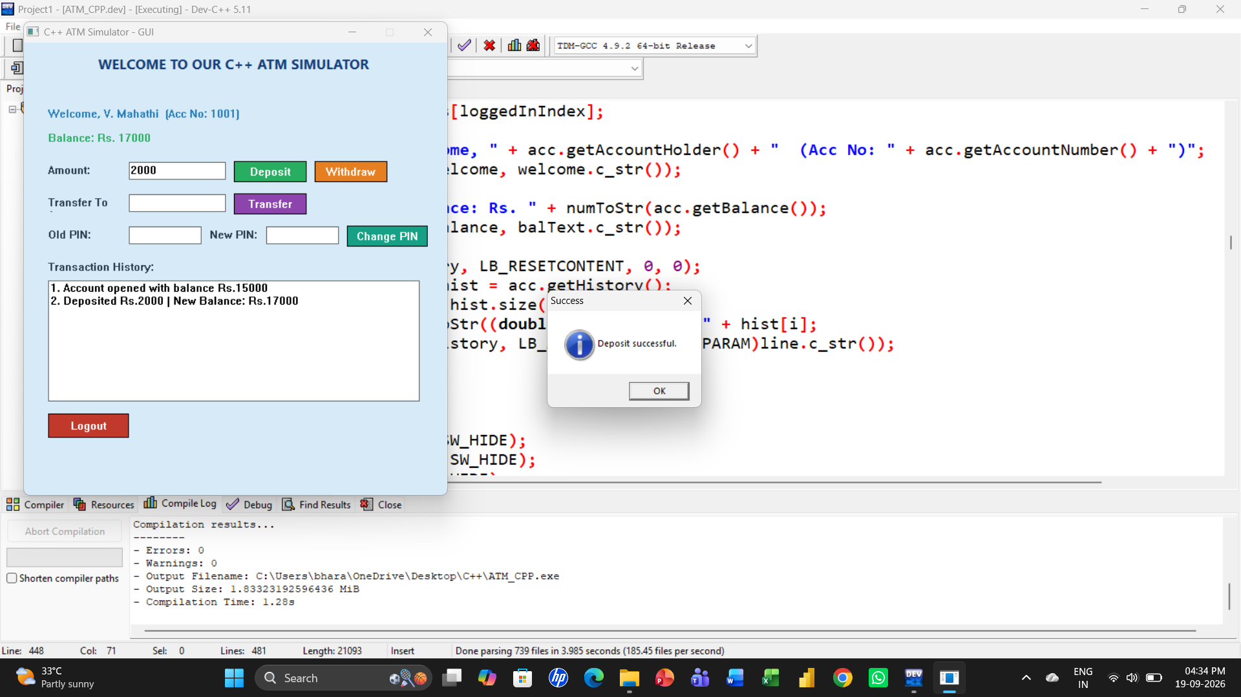

Slide 22
Team Member Contributions:
Team Member | Contribution
R.P.Chandrasekhar | Code Implementation Account and ATM classes, login, deposit, withdraw and transfer.
T. Sanjana | PPT Review slides and project presentation.
K. Jaswanthi | Documentation Project report and user guide.
P.Haribabu | GUI Implementation & Testing Interface design and test cases for every module.

Slide 23
Conclusion
The Restaurant Management System shows how the basic restaurant operations work in C++: Order ID customer login, order total check, add item, remove item, and order history.
Object-oriented concepts (classes, encapsulation) keep the code organised and easy to maintain.
A Order structure and an STL vector store every order dynamically, so the history can be viewed at any time.
Input checks handle errors such as a wrong Order ID or insufficient order total.
The project gave us practical experience with C++, STL, and teamwork, and it can later be extended with file or database storage, multiple customers, and stronger security.

Slide 24
THANK YOU

